Slide 1
APOLOGETICS
IN ONE LESSON
almost
Ai1L.net
Lesson 17
The Gospel According to God (Isaiah 53)

Slide 2
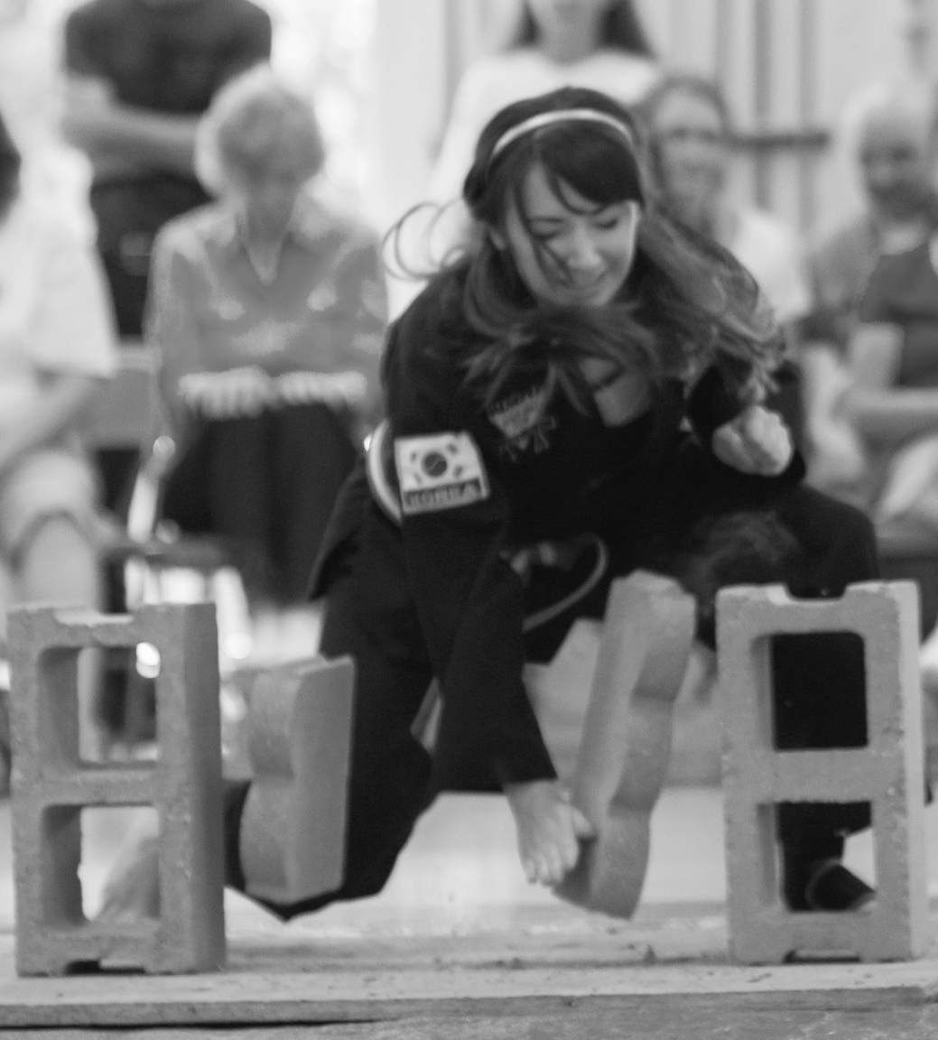

Slide 4
Isaiah Quotations

Slide 5
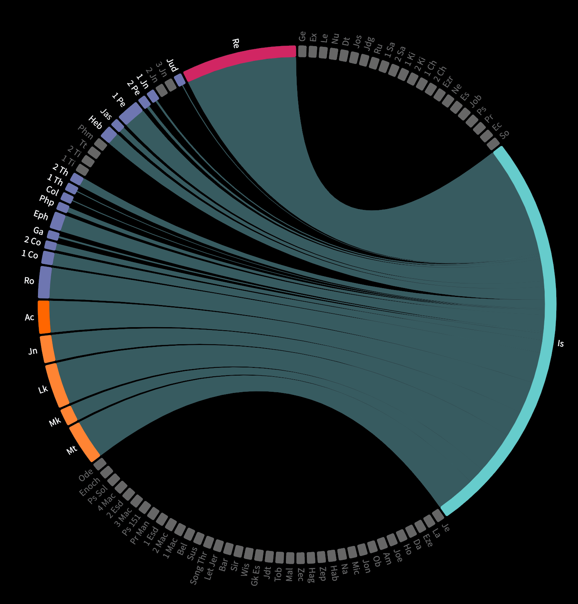

Slide 6
Isaiah Outline
1-39
judgment leading to captivity
40-66
God’s saving work for deliverance
40-48
deliverance from Babylonian captivity
49-57
deliverance from sin
53:5
center of this section: the cross
55
call to faith for the promise of salvation
56
mercy extends to Gentiles
57
condemnation of harsh leaders
58-66
full deliverance from the fall

Slide 7
Past Tense
Appalled at him
Disfigured
Message was not believed
Grew up like a tender shoot
Despised and rejected
Took on others’ infirmities
Pierced for our transgressions
Sheep have gone astray
Lord laid iniquity on him
Didn’t open his mouth
Led to the slaughter
Cut out from the land of the living
Soul made a guilt offering
Done no violence
Bore the sins of many
Made intercession for the transgressor
Future Tense
Prosper
Exalted
Sprinkle many nations
Kings will shut their mouths
Those who did not see will understand
See his offspring
Prolong his days
See the light of life
Allotted a portion with the great
Justify many, bear their iniquities
Divide the spoils with the strong

Slide 8
52:13-15 | Astonishment
53:1-3 | Rejection
53:4-6 | Substitution
53:7-9 | Silence
53:10-12 | Triumph

Slide 9
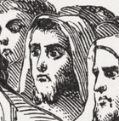
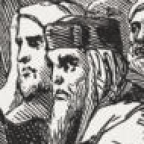
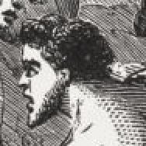
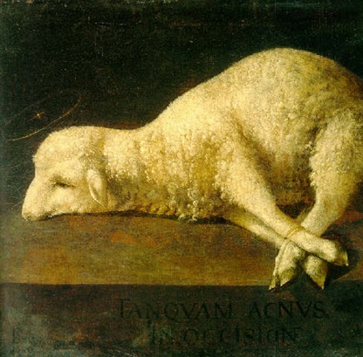
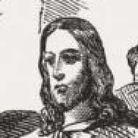
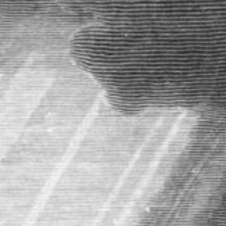
52:13-15 | Astonishment
53:1-3 | Rejection
53:4-6 | Substitution
53:7-9 | Silence
53:10-12 | Triumph

Slide 10
Astonishment (52:13-15)
1

Slide 11
Rejection (53:1-3)
2

Slide 12
Substitution (53:4-6)
3

Slide 13
Silence (53:7-9)
4

Slide 14
“As a sheep, when the shearer is stripping it of its clothing, makes neither noise, nor resistance; and as a lamb sports about even while being driven to the slaughter, yea, and licks the very hand that is lifted up to slay it, so our blessed Lord endured all his sufferings silently, willingly, and with expressions of love to his very murderers”
CHARLES SIMEON Horae Homileticae

Slide 15
“At a slaughterhouse for cattle, the mooing is deafening. At the slaughterhouse for pigs, the squealing is deafening. But if you were to visit a slaughterhouse for lambs, the silence is deafening .”
TOMMY PEELER Behold, My Servant – Isaiah 53 (18:20)

Slide 16
Astonishment (52:13-15)
5

